Slide 1

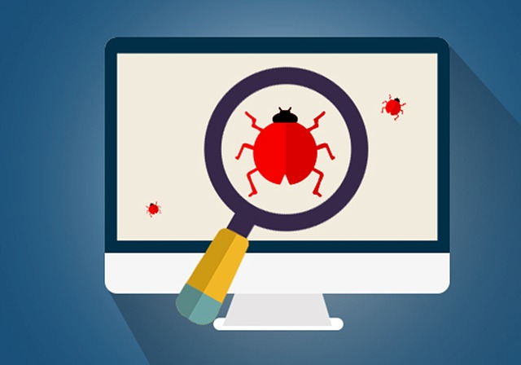
CSE 455 software Testing
Lecture 1
This course is offered to the students of BS Software Engineering who are enrolled in 8th semester
Notes:
NOTE:
To change the image on this slide, select the picture and delete it. Then click the Pictures icon in the placeholder to insert your own image.

Slide 2
Course instructor Yella mehroze
yellamehroze@cuilahore.edu.pk

Slide 3
Outline
Introduction
Learning Objectives
Text / Reference Books
Rules
Verification v/s Validation
Quality Assurance v/s Quality Control
Formal Definition of Software Testing
What is a Bug?
Why do Bugs Occur?
Symptoms and Root Causes of Bugs
Cost of Bugs

Slide 4
Introduction
What is your Name?
What is your Final Year Project?
What you know about Software Testing?
What are your expectations from this course?

Slide 5
Learning Objectives
After completing this course the students will be able to:
Determine software testing objectives and criteria
Select and prepare minimum number of test cases in case of both black box and white box testing
Develop and validate a test plan
Do effective test reporting
Observe bug’s life cycle and bugs categories
Identify the need for testing
Perform different types of testing on your projects
Measure the success of testing effort

Slide 6
Text / Reference Books
Text Book
Software Testing by Ron Patton Second Edition
Reference Books
Software Testing Principles and Practices by Srinivasan Desikan and Gopal Aswamy Ramesh
Software Testing Techniques 2nd Edition by Boris Beizer
Software Quality Assurance from Theory to Implementation By Daniel Galin

Slide 7
Some Rules
Mobile Phones
Should be Silent / Vibration Mode
Punctuality
Arrive on time
Absent will be marked if you are more than 10 min late
Attendance
80 % attendance required to appear in the exams
No compromise
Assignments
Should be submitted on time
Should not be copied, otherwise graded zero
No disturbance during lecture
Quizzes
All quizzes will be graded and marks will be uploaded on cu-online
No late submission
No retake
No retake

Slide 8
Basic definitions
Revision of some basic concepts

Slide 9
Verification v/s Validation
Verification: The software should confirm to its specification (Are we building the product right?)
Validation: The software should do what the user really requires (Are we building the right product?)

Slide 10
Quality Assurance v/s Quality Control
DEFINITION
Quality Assurance: QA is a set of activities for ensuring quality in the processes by which products are developed.
Quality Control: QC is a set of activities for ensuring quality in products. The activities focus on identifying defects in the actual products produced.

Slide 11
Quality Assurance v/s Quality Control
FOCUS ON
Quality Assurance: QA aims to prevent defects with a focus on the process used to make the product. It is a proactive quality process.
Quality Control: QC aims to identify (and correct) defects in the finished product. Quality control, therefore, is a reactive process.

Slide 12
Quality Assurance v/s Quality Control
GOAL
Quality Assurance: The goal of QA is to improve development and test processes so that defects do not arise when the product is being developed.
Quality Control: The goal of QC is to identify defects after a product is developed and before it's released.

Slide 13
Quality Assurance v/s Quality Control
HOW
Quality Assurance: Establish a good quality management system and the assessment of its adequacy. Periodic conformance audits of the operations of the system.
Quality Control: Finding & eliminating sources of quality problems through tools & equipment so that customer's requirements are continually met.

Slide 14
Quality Assurance v/s Quality Control
WHAT
Quality Assurance: Prevention of quality problems through planned and systematic activities including documentation.
Quality Control: The activities or techniques used to achieve and maintain the product quality, process and service.

Slide 15
Quality Assurance v/s Quality Control
RESPONSIBILITY
Quality Assurance: Everyone on the team involved in developing the product is responsible for quality assurance.
Quality Control: Quality control is usually the responsibility of a specific team that tests the product for defects.

Slide 16
Questions
Verification is an example of?
Quality Assurance
Quality Control
Validation is an example of?
Quality Assurance
Quality Control

Slide 17
Quality Assurance v/s Quality Control
EXAMPLE
Quality Assurance: Verification is an example of QA.
Quality Control: Validation/Software Testing is an example of QC.

Slide 18
Quality Assurance v/s Quality Control
AS a TOOL
Quality Assurance: QA is a managerial tool.
Quality Control: QC is a corrective tool.

Slide 19
Quality Assurance v/s Quality Control
ORIENTATION
Quality Assurance: QA is process oriented.
Quality Control: QC is product oriented.

Slide 20
Software Testing
Testing is the process of executing a program with intention of finding errors.

Slide 21
Formal Definition of Software Testing
Software testing is a formal process carried out by a specialized testing team in which a software unit, several integrated software units or an entire software package are examined by running the programs on a computer. All the associated tests are performed according to approved test procedures on approved test cases.

Slide 22
Formal Definition of Software Testing
Formal:
Software test plans are part of project’s development and quality plans, scheduled in advance
It is often signed between developer and customer
Ad hoc examination by colleague and or regular checks by the programming team leader cannot be considered software tests

Slide 23
Formal Definition of Software Testing
Specialized testing team:
An independent team or external consultants who specialize in testing are assigned to perform these tasks to
Eliminate bias
Guarantee effective testing
Tests performed by the developers themselves will yield poor results
Unit tests continue to be performed by developers in many organizations

Slide 24
Formal Definition of Software Testing
Running the programs:
Any form of quality assurance activity that does not involve running the software, for example code inspection cannot be considered as a test.
Approved test procedures:
The testing process performed according to a test plan and testing procedures
These are approved SQA procedures adopted by the developing organizations

Slide 25
Formal Definition of Software Testing
Approved test cases:
The test cases to be examined are defined in full by the test plan.
No omissions or additions are expected to occur during testing.

Slide 26
What is a Bug?
Informally, it is “what happens when software fails”, whether the failure was
Inconvenient
Catastrophic
Terms for software failure
* Fault * Anomaly * Problem
* Inconsistency * Failure * Incident
* Error * Defect
* Variance * Bug

Slide 27
What is a Bug?
Formally, we say that a software bug occurs when one or more of the following five rules is true: when the software
doesn't do something that the product specification says it should do.
does something that the product specification says it shouldn't do.
does something that the product specification doesn't mention.
doesn't do something that the product specification doesn't mention but should.
is difficult to understand, hard to use, slow, or will be viewed by the end user as just pain not right.
Notes:
Product Specification: “an agreement among the software development team. It defines the product they are creating, detailing what it will be, how it will act, what it will do, and what it won't do”

Slide 28
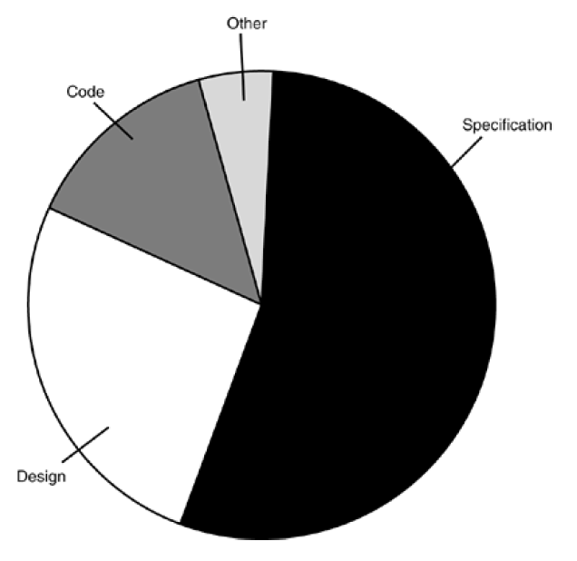
Why do Bugs Occur?

Slide 29
Symptoms and Root Causes of Bugs
Inaccurate understanding of end user needs
Inability to deal with changing requirements
Modules that don’t fit together
Software that is hard to maintain or extend
Late discovery of serious project flaws
Poor software quality
Unacceptable software performance
Team members in each other’s way, making it impossible to reconstruct who changed what, when, where and why
An untrustworthy build-and-release process

Slide 30
The Cost of Bugs

Slide 31
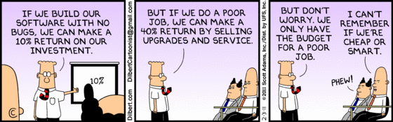
The Cost of Bugs

